Slide 1
Quiz
APA Chapter 3
5 Questions

Slide 2
APA Method Section
Lecture 8

Slide 3
What the methods section tells us
The introduction answers “why” we’re doing our study
The method section answers “how” we’re doing our study
It also answers
  Who – Who are our participants?
  What – What types of measures did we use? What was our manipulation?
  Where – Where did this take place? (Is this even important?)
  How – How did we measure our constructs? How did we do the experiment?

Slide 4
What the methods section tells us
The methods section allows the reader to evaluate your methods and results.
  Did we use “good” measures (reliability/validity)?
  Does our manipulation make sense?
  Do we have enough participants?
  Are there potential confounds that weren’t measured?
The methods section allows the reader to replicate (or modify and improve) our study

Slide 5
APA Formatting
Verb tense
  If you’ve already conducted the study, past tense
  If you are proposing a study, future tense
Format “Method” using formatting for a level 1 header
Methods sections should include sections for
  Participants
  Materials
  Procedure
  Design
  Analyses
These sections should be formatted using formatting for a level 2 header

Slide 6
Format for 5 levels of heading in APA journals
Level of heading | Format
1 | Centered, Boldface, Uppercase and Lowercase
2 | Flush Left, Boldface, Uppercase and Lowercase
3 | Indented, boldface, lowercase paragraph heading ending with a period.
4 | Indented, boldface, italicized, lowercase paragraph heading ending with a period.
5 | Indented, italicized, lowercase paragraph heading ending with a period.

Slide 7
Participants
The number of participants in the study (N = ?)
The screening criterion
  Which, if any, participants were excluded and why
Where the participants were recruited
Whether the participants were compensated
Basic demographic characteristics
  General characteristics (undergraduate students, psychiatric patients, etc.)
  Age, gender/sex, race/ethnicity, nationality, income level, profession, relationship status
  Only include what’s relevant in your study (Political affiliation may not be important for all studies)

Slide 8
Materials
Include all materials to be used for the study
  Computers, special programs, EEG machines, fMRI, speakers (and speaker location relative to participant), etc.
Include all measures and information for each measure
  Name the measure
  Cite the original article in which the measure was presented
  Short description of the measure
  Sample items (only one or two)
  The number of items
  Response format (Likert scale, open-response, true/false, etc.)
  Interpretation (what high scores versus low scores mean)
  The measure’s validity and reliability
  If you made your own measure, you need to say how you created the items and how you tested validity and reliability (unless you’ve already published an article on that)
Notes:
For this assignment, you will include the whole measure in the appendix

Slide 9

Procedure
This section should explain step-by-step of how you will collect the data
  Think about a recipe. If you’re telling someone how to make a peanut-butter and jelly sandwich who has never made one before, you want to include all of the important steps
If another researcher couldn’t repeat the experiment based on what you’ve written, then you should add more detail

Slide 10
Procedure
Write this section in the order of how the study will take place
Discuss the experimental design to the extent that it’s important
  For example, participants will be randomly assigned to one of three conditions
What instructions were given to the participants
  For example, participants will be asked to read a vignette regarding a US climate change policy. Participants will then indicate the extent to which they endorse the policy change on a scale ranging from 1 (don’t support the policy) to 7 (strongly support the policy)
When and where did the experiment take place (if applicable)
How was the experiment conducted
  Did participants complete paper and pencil measures or internet surveys
Was there a debriefing if the study involved deception

Slide 11
Miscellaneous
Do NOT include limitations or confounds
Length will vary depending on how detailed you are
  Usually between 1 and 2 pages
Ask if you have questions!!!

Slide 12
Begin thinking about (and working on) your group PowerPoint presentations
Your group presentations are going to be very similar to your individual papers. The only exception should be the results, since you won’t have results for the group presentations.
Group Presentation
Individual Papers
Title
Abstract
Introduction
Methods
Expected results (based on hypotheses)
References
Cover page
Abstract
Introduction
Methods
Results
References

Slide 13
In-Class Activity

Slide 14
Methods Activity
Use the information from the exploratory factor analysis from the previous lecture to write up a brief methods section based on the EFA data
Include a Reference list at the end citing any articles referred to in your Methods section
Use the information from the AttachCon paper on Blackboard
Do NOT quote or plagiarize from the AttachCon paper
Write your paper on the document shared with you in Google Docs. Each person should contribute.
Submit your final document on Blackboard. This is a group activity. Only one person needs to submit on Blackboard

Slide 15
Citations pulled from AttachCon paper
Ruehlman. L.S., & Karoly, P. (1991). With a little flak from my friends: Development and preliminary validation of the Test of Negative Social Exchange (TENSE). Psychological Assessment, 13, 97-104.
Simpson, Jeffry A. (1990). Influence of attachment styles on romantic relationships. Journal of Personality and Social Psychology, 59, 971-980.
Simpson, J.A., Rholes, W.S, & Nelligan, J. (1992). Support Seeking and Support Giving Within Couples in an Anxiety-Provoking Situation: The Role of Attachment Styles. Journal of Personality and Social Psychology, 62, 434-446.

Slide 16
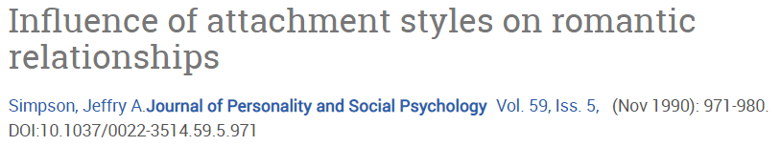



Slide 17
Simpson (1990)
Attachment measure
Participants respond on a 7-point Likert-type scale from (1) strongly disagree to (7) strongly agree
(a) “I find it relatively easy to get close to others,”
(b) “I'm not very comfortable having to depend on other people,”
(c) “I'm comfortable having others depend on me,”
(d) “I rarely worry about being abandoned by others,”
(e) “I don't like people getting too close to me,”
(f) “I'm somewhat uncomfortable being too close to others,”
(g) “I find it difficult to trust others completely,”
(h) “I'm nervous whenever anyone gets too close to me,”
(i) “Others often want me to be more intimate than I feel comfortable being,”
(j) “Others often are reluctant to get as close as I would like,”
(k) “I often worry that my partner(s) don't really love me,”
(l) “I rarely worry about my partner(s) leaving me,”
(m) “I often want to merge completely with others, and this desire sometimes scares them away.”

Slide 18
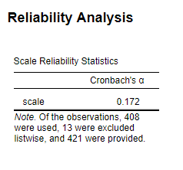
Reliability for Simpson (1990)

Slide 19
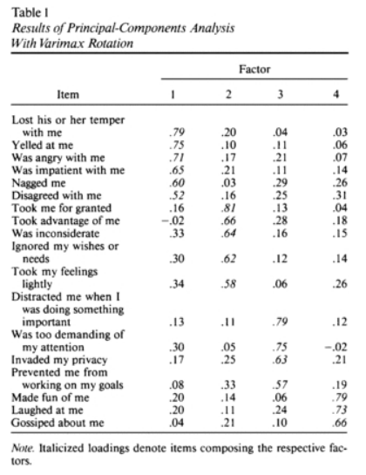
Ruehlman and Karoly (1991) Test of Negative Social Exchange (TENSE)

Slide 20
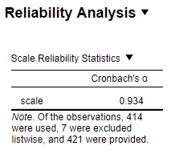
Cronbach’s alpha (reliability) for Ruehlman and Karoly (1991) Test of Negative Social Exchange (TENSE)

Slide 21
Important information from the AttachCon paper
436 Intro to Psych students recruited
Data for 17 participants wasn’t used because of missing data or failure to follow instructions
Data for 421 participants used in analyses
Between the ages of 18 and 26 with an average age of 19.2-years-old (standard deviation – 1.51)
259 women (61.5%) and 162 men (38.5%)
For attachment measure cite Simpson references
For conflict measure, cite Ruehlman reference and Finch reference
  Test-retest reliability between .65 to .80 Ruehlman reference
Participants were asked to think about their past month interactions with the important people in their lives (other than family members).

Slide 22
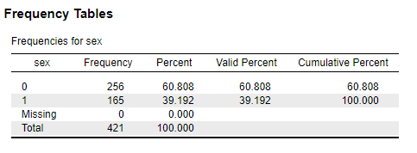
Participant demographic information
(men are 1 and women are 0)

